Slide 1
Network Design for Huhtamaki India Ltd.

Slide 2
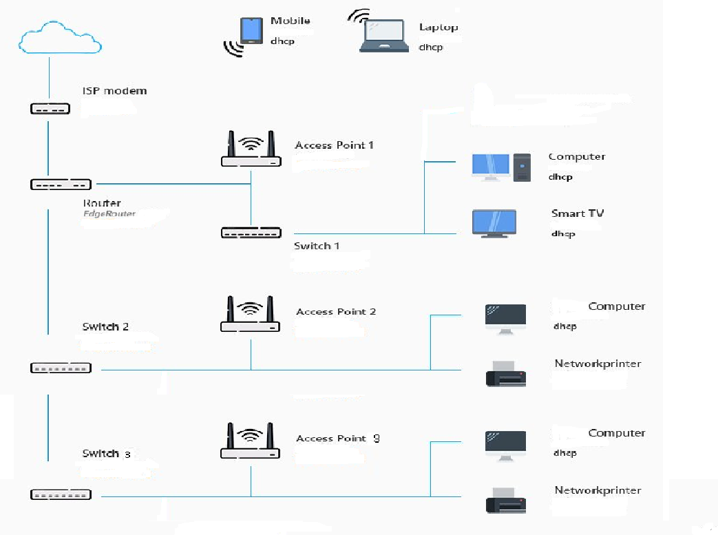
Basic Block Diagram

Slide 3
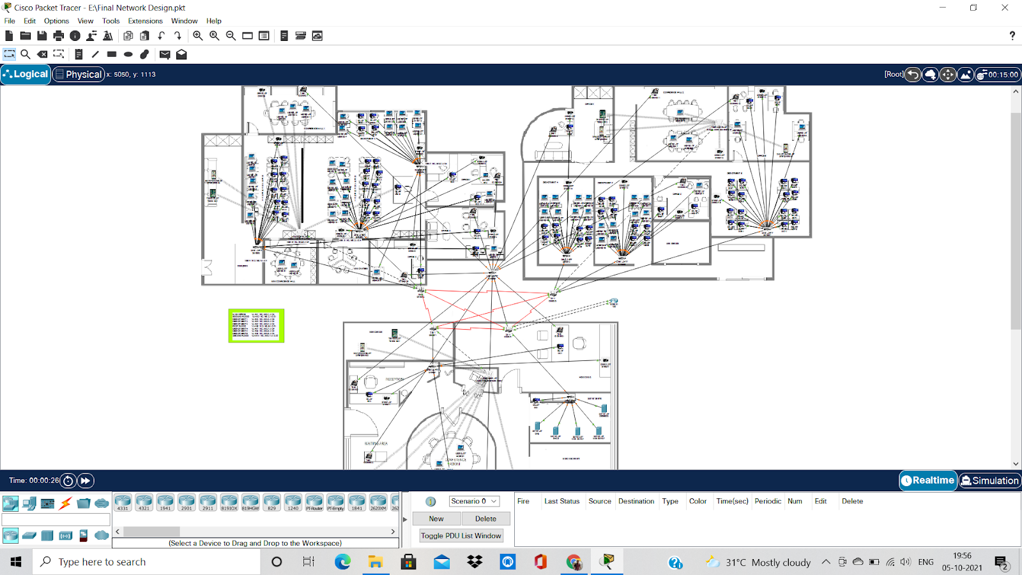
Main Network Design

Slide 4
BILL OF MATERIALS
Serial No. | Name Of Hardware Used | No. Of Hardware Used | Approximate Price/component | Total Price
1 | Server | 5 | 1,00,000/- | 5,00,000
2 | Router | 3 | 5,000/- | 15,000
 |  | 1 | 8,000/- | 8,000
3 | Switch | 10 | 8,500/- | 85,000
4 | Access Point | 3 | 2,500/- | 7,500
5 | PC | 250 | 30,000/- | 75,00,000
6 | Laptop | 200 | 25,000/- | 50,00,000
7 | Printer | 17 | 20,000/- | 3,40,000
8 | IP Phone | 15 | 4,000/- | 60,000
9 | Cable (Cat6) | 10 Bundles (305m) | 5,000/- per bundle | 50,000
10 | Cable (Serial DTE) | 500m | 1200/- per meter | 60,000
11 | RJ45 Connector | 2000 Pieces | 350/- per packet (100 Pieces) | 7,000
12 | RJ11 Connector | 100 Pieces | 300/- per packet (50 Pieces) | 600
Total Cost |  |  |  | 1,36,33,100/-

